Slide 1
Senior Project Introductory Video: Robotic Arm 1.0
Team Members: Curtis Cox and Shadeh Ferris-Francis
Product Owner and Mentor: Dr. Nagarajan Prabakar
Instructor: Masoud Sadjadi

Slide 2
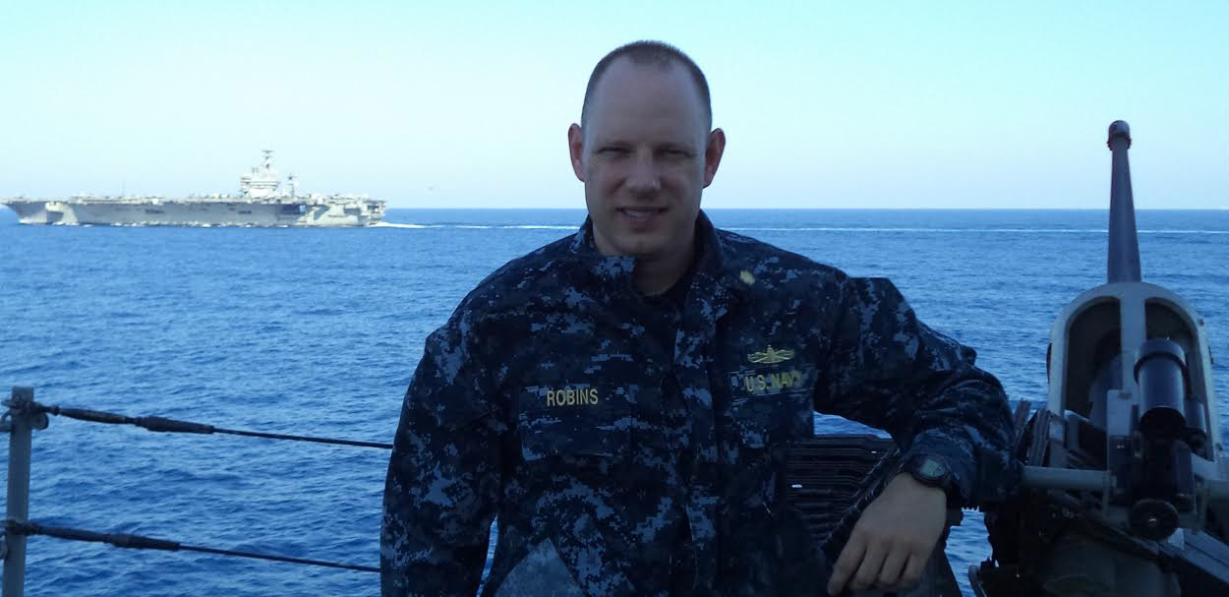
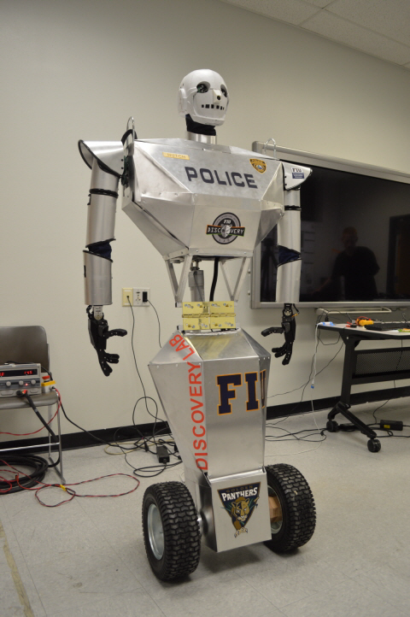
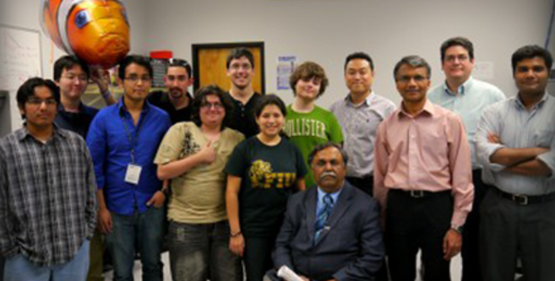
Inception

Slide 3
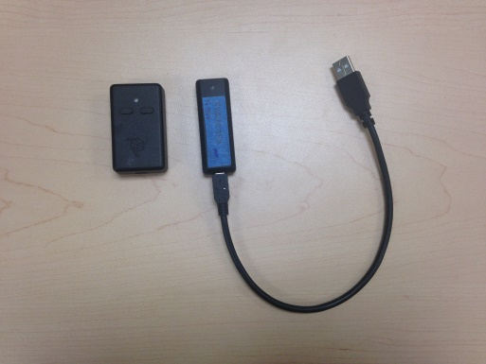
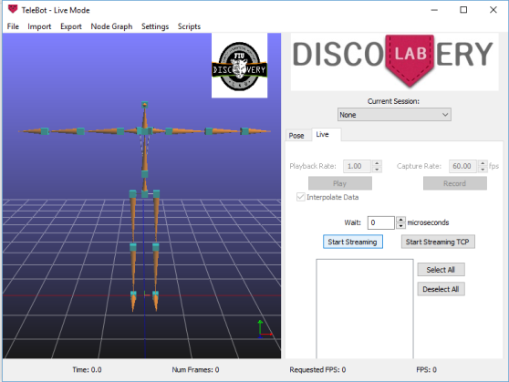
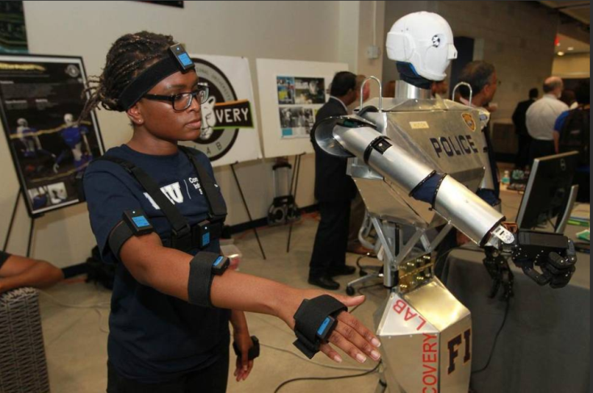
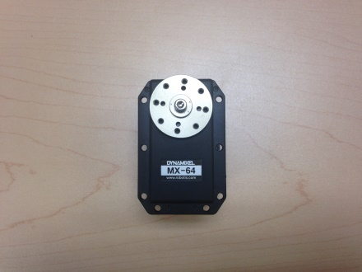
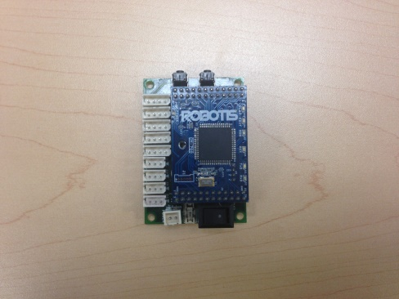
Current System

Slide 4
Setbacks
Accuracy
Usability
User Control
Testing

Slide 5
Proposed Solution
Quaternion Angles
User-Friendly Interface and Operation
Alternative Modes of Operation, such as Voice-Commands
Servomotor Test Program

Slide 6
Requirements
Activate DDS Publishing when clicking Activate DDS Button
Display Angular Data Received for Each Joint in the IMU Master/Publisher GUI
Process Angular Data to Servomotor Units with IMU Master/Publisher Program
Connect Mocap System to IMU Master/Publisher Program
Initiate Mocap Halt Rest Position
Process Commands to Servomotor Units with Voice Master/Publisher Program
Connect Voice Control System to Voice Master/Publisher Program
Understand DDS Message delivery
Arm Servo Test Driver
Monitor Servo Feedback
DDS servo correction
Minimize Servo Feedback Latency
Improve the Mocap algorithm
Develop Arm Quaternion Calculation Algorithm

Slide 7
System Design

Slide 8
Voice Control System Example

Slide 9
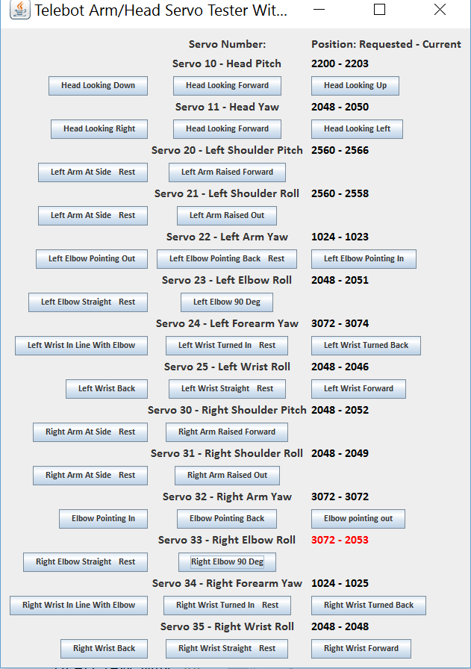
Servo Tester GUI

Slide 10
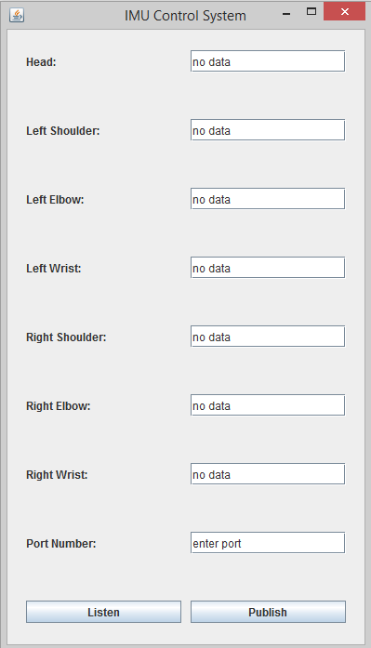
IMU Master/Publisher GUI

Slide 11
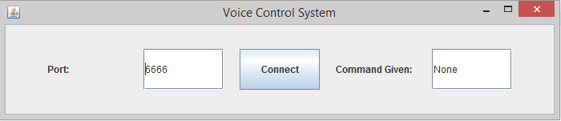
Voice Master/Publisher GUI

Slide 12


